Slide 1
Lower Bounds for Constant Multiplication Problems
DIPJYOTI DAS(160102022)
AMARTYA ROY(160102006)

Slide 2
The Problem
What is the problem?
How a general multiplier can be replaced by a network of shifts, adders, and subtractors.
How this problem is solved?
Comparing efficient algorithms to use minimum numbers of shifts, adders, and subtractors.

Slide 3
Background Information
Research Topic : Lower Bounds for Constant Multiplication Problems
Reference Paper: Lower Bounds for Constant Multiplication Problems
Oscar Gustafsson Publication Year: 2007, Page(s):974-978

Slide 4
LOWER BOUNDS ON THE NUMBER OF ADDERS
Single Constant
Multiple Constants
Sum of Products
Constant Matrix
FIR Filter

Slide 5

Representation
The lower bounds are denoted as A_{LB} and D_{LB} for adder cost and adder depth , respectively. An integer coefficient can be represented using a B–digit radix-2 signed-digit representation as
C =$\sum_{k=0}^{B−1}{ck}$ 2^{k}
Where $ck$ ∈ {-1,0,1}. A representation with a minimum number of nonzero digits, , is called a minimum signed-digit (MSD) representation. We denote the minimum number of nonzero digits for C as S$\left(C\right).$

Slide 6

Single Constant multiplication(SCM)
Where [x] denotes the smallest integer number equal to or larger than x.
Binary Multiplication: The straightforward method for decomposing the multiplication into adds and shifts translates 1’s in the binary representation of the constant t into shifts, and adds up the shifted inputs. For example,
for t = 71,
71x = 1000111₂x = x ≪ 6 + x ≪ 2 + x ≪ 1 + x
which requires 3 adds.

Slide 7
CSD Representation: A better digit-based method decomposes into both adds and subtracts by recoding the number into the canonical signed digit (CSD) representation [Avizienis 1961], which allows negative digits 1’. Using CSD, the previous example can be improved to use only 2 add/subtract operations:
1000111₂x = 1001001’_{CSD}x = x ≪ 6 + x ≪ 3 − x
Graph Representation of Multiplication : Multiplication by a constant integer can be described in terms of a graph as follows. There is an initial vertex of the graph, which can nominally be assigned the value 1. There is a terminal vertex of the graph, which is assigned the value of the multiplier being designed. The multiplicand can be considered as being input to the initial vertex. The product is output from the terminal vertex. Each vertex of the graph except the initial vertex represents an adder, which has two inputs, and can have any number of outputs. Each edge of the graph can be assigned a value of ( +- 1, 2, 4, 8,... ), representing multiplication of the value of the initial vertex of that edge by a value which can be implemented as a binary shift.

Slide 8
The Bull and Horrocks Algorithm modified : The basis of the algorithm is that it starts with the input ("1")vertex, and takes all pairwise sums of powers-of two multiples of that vertex. The sum closest to the required multiplier value is added to the graph as a vertex. This process is repeated, using powers of- two multiples of all vertices in the graph, until the multiplier value is added to the graph.
The Bernstein Algorithm and The n-dimensional Reduced Adder Graph (RAG-n) Algorithm are also used.

Slide 9
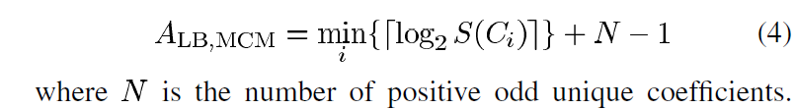
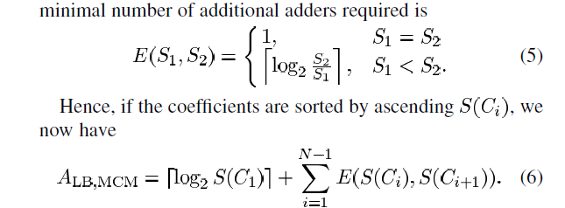
Multiple Constant Multiplication (MCM)
An extension of SCM is the problem of multiplying a variable x by several constants t1, . . . , tn in parallel in a so-called multiplier in the given figure. Since intermediate results of the constant decompositions may be shared, a multiple constant multiplier block may be decomposed into fewer operations than the sum of the single constant decompositions’ operation counts. The problem of finding the decomposition with the fewest operations is known as Multiple Constant Multiplication (MCM).
An initial lower bound is now:

Slide 10
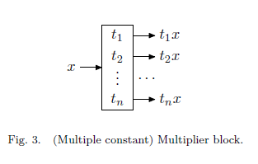
Existing algorithms :The existing MCM algorithms can be divided into four
general classes:
—Digit-based recoding;
—Common subexpression elimination (CSE) algorithms;
—Graph-based algorithms;
—Hybrid algorithms.

Slide 11
Digit-based recoding includes simple methods like CSD and the binary method. They generate the decomposition directly from the digit representation of the constant. These methods are the fastest and the worst performing ; however, a more recent approach [Coleman 2001] uses different number systems to yield considerably better solutions. The main advantage of digit-based recoding is their low computational cost, typically linear in the number of bits. As a consequence, these methods can be easily applied to constants with thousands of bits.
Common subexpression elimination (CSE) algorithms are direct descendants of digit-based recoding methods. The basic idea is to find common sub patterns in the representations of the constants after the constants are converted to a convenient number system such as CSD. Examples for this method include [Pasko et al. 1999; Lef`evre 2001; Hartley 1996]. The disadvantage, however, is that the performance of these algorithms depends on the number representation.

Slide 12
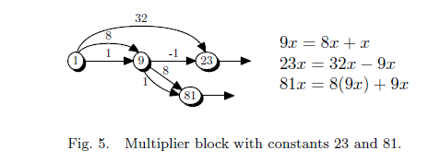
Graph-based algorithms are bottom-up methods that iteratively construct the graph representing the multiplier block. The graph construction is guided by a heuristic that determines the next graph vertex to add to the graph.
There are also approaches like Hybrid algorithms etc.

Slide 13
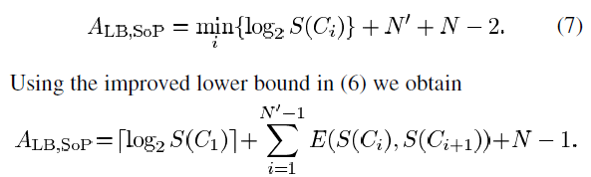
Sum of product MULTIPLICATION
For a sum of products with N terms of which N’ are unique we have based on the MCM case

Slide 14
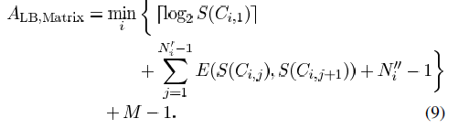

Matrix multiplication
For a constant M $×N$ matrix, i.e., M rows and N columns , we have a similar extension from the sum of products problem as from single to multiple coefficients. Therefore , an initial lower bound is the minimal number of adders for one row plus at least one adder for each additional row. For row , we denote the number of unique elements N’_{i} and the number of nonzero elements as N_{i}’’ . Hence, we get

Slide 15
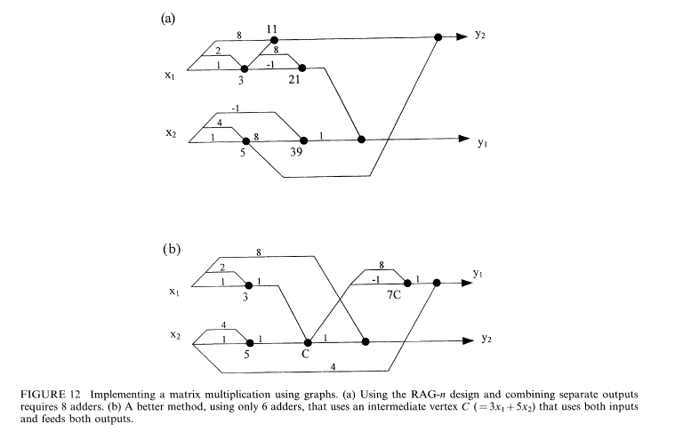


Now for example, the matrix equation.This method uses 7 adders.

Slide 16
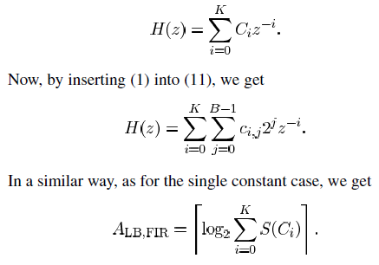

FIR FILter multiplication
Assume that we have an M FIR filter of order k with transfer function

Slide 17



Lower bound of adder depth
For a single coefficient, we have
For the multiple constant multiplication problem
In a similar way as for a single coefficient, we get for a sum of products

Slide 18


for matrices
Finally, for FIR filters, we have

Slide 19
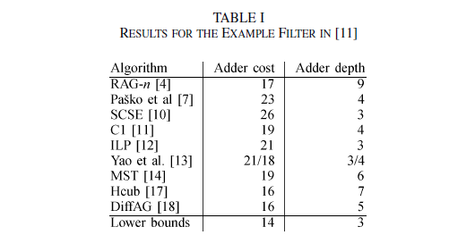
Results:

Slide 20
conclusion
In this brief, we have proposed lower bounds on the number of adders, the adder cost, and the number of cascaded adders, the adder depth, when realizing single and multiple multiplications and sum-of-products using shifts and adders. The lower bounds have applications in proving the optimality of solutions obtained by heuristics. Furthermore, they can be used to get an initial rough complexity estimate (downwards).

